Slide 2
Overview of infertility
Razieh Akbari Dr
Assistant Professor Of Obstetrics And Gynecology
Tehran University of Medical Sciences

Slide 3
DEFINITIONS
In women less than 35 years of age
In women 35 years and older

Slide 4
PREVALENCE OF INFERTILITY
The frequency of primary infertility in married women by age groups was: women 15 to 34 years (7.3 to 9.1 percent), 35 to 39 years (25 percent), 40 to 44 years (30 percent).

Slide 5
CAUSES OF INFERTILITY
Male factor (hypogonadism, post-testicular defects, seminiferous tubule dysfunction) – 26 percent
Ovulatory dysfunction – 21 percent
Tubal damage – 14 percent
Endometriosis – 6 percent
Coital problems – 6 percent
Cervical factor – 3 percent
Unexplained – 28 percent

Slide 6
When is the fertile period of the cycle?
six days and includes the five days prior to ovulation plus the day of ovulation
The highest probability of conception occurs when intercourse takes place one to two days prior to ovulation and on the day of ovulation

Slide 7
predict the time of ovulation
fertility apps
changes in cervical mucus
using a kit to measure urinary luteinizing hormone (LH).
However, for most women, there is no substantial evidence that self-monitoring to predict ovulation increases cycle fecundability

Slide 8
What is the optimum coital frequency to achieve conception?
optimum semen quality, measured in terms of motility, morphology, and total sperm count, occurs when there are two to three days of ejaculatory abstinence; longer intervals are associated with lower pregnancy rates

Slide 9
Effect of lubricants
KY jelly, Astroglide, Touch, Replens, olive oil, saliva, KY Sensitive, KY Warming, KY Tingling
mineral oil, canola oil, mustard oil, or hydroxyethylcellulose-base (Pre-Seed)

Slide 10
Coital factors
Coital position,
presence or absence of female orgasm, and
female position (eg, remaining supine) after male ejaculation

Slide 11
Tobacco use
Female partner
Male partner

Slide 12
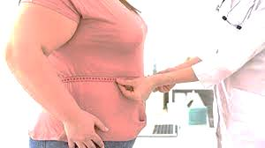
Overweight and obesity
Female partner
Male partner

Slide 13
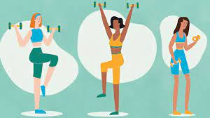
Exercise
Female partner
Male partner

Slide 14
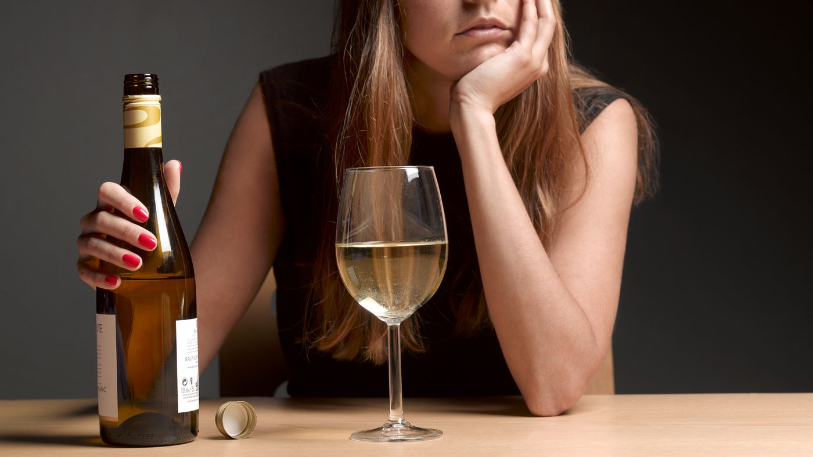
Alcohol intake
Female partner
Male partner

Slide 15
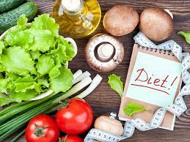
Diet
Female partner
Male partner

Slide 16
Caffeine

Slide 17
Stress

Slide 18
Environmental factors

